Slide 1
Comparison of various approaches to remove batch effects
Mengyi Liu (刘梦怡)
Sep. 17th, 2018
Notes:
今天是我暑假实习最后一天了， 给大家做一个总结报告。
征得张老师意见

Slide 2

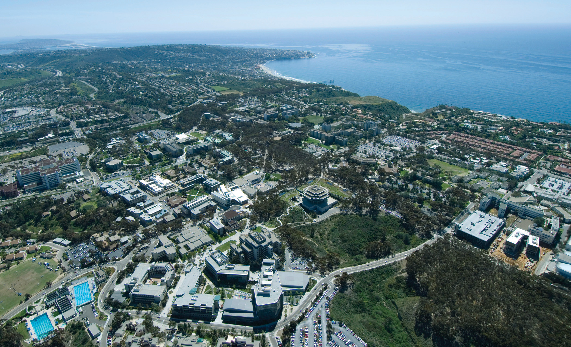
Background
4th year undergrad at UC San Diego
Bioinformatics
Previous labs:
San Diego Supercomputer Center (SDSC):
Deep learning
UCSD Center for Computational Biology and Bioinformatics (CCBB):
RNA-seq, miRNA-seq pipelines
Pathway analysis
No prior experience with R or single cell RNA-seq analysis tools
Notes:
what I did during the summer was brand new for me
It took me some time to learn R and the tools I used.
And it was great that I learnt so much,
with the help of Dr. Ren and some of you.

Slide 3
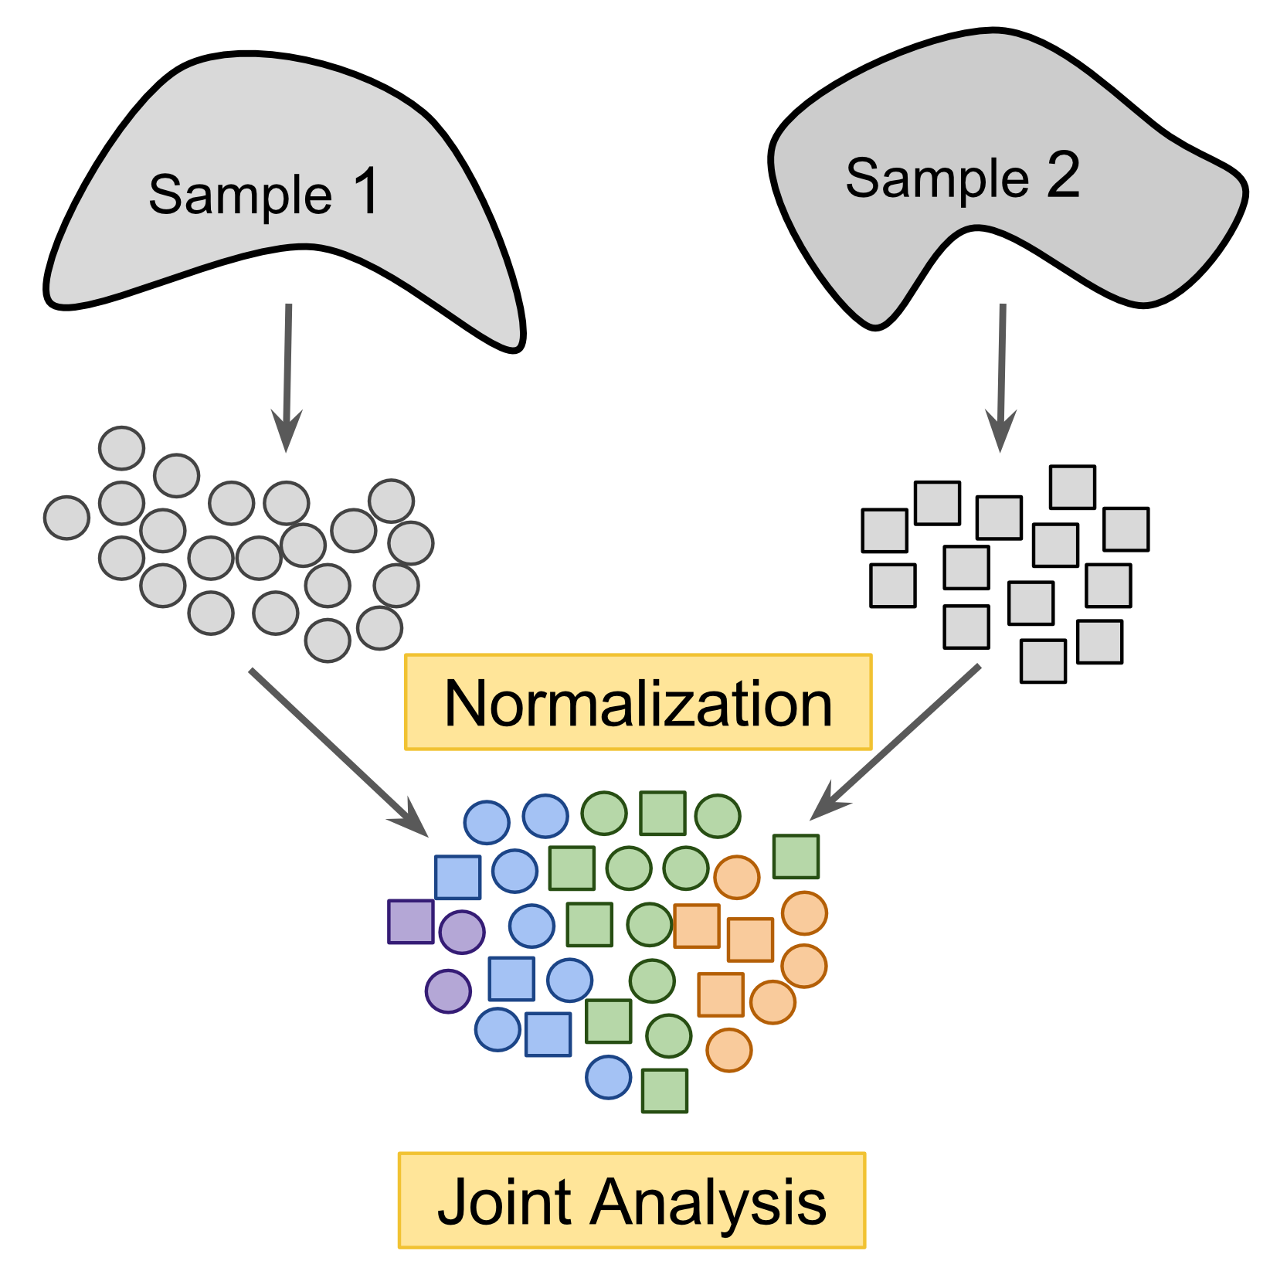
Project: Remove Batch Effects
Goal:
Compare the effectiveness of different approaches to remove batch effects in single-cell RNA-seq datasets
Quantification:
How well each method separates the cell types and mix the batch (NMI)
To what extent each method distort the original data (Spearman correlation)
Notes:
Batch effects:
multiple labs using:
different protocols,
Library-preparation technologies
sequencing platforms
in order to quantify how effective the methods are
(Normalized mutual information: larger values indicate a better correlation between the two

Slide 4
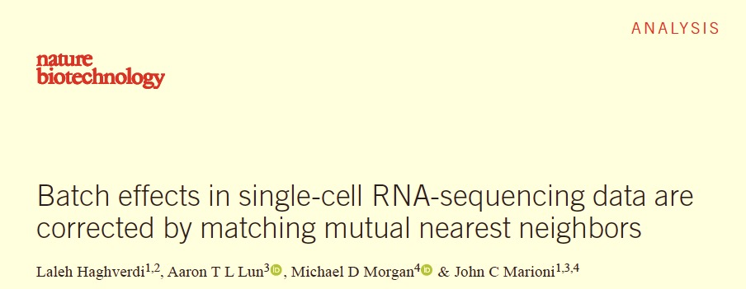

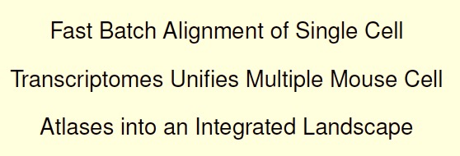
Methods
6 different methods:
MNN
Seurat
Limma
ComBat
Quantile Normalization
BBKNN

Slide 5
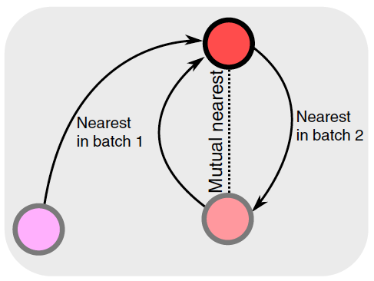
MNN: Mutual Nearest Neighbors
Does not rely on equal population compositions across batches
Only requires a subset of population shared across batches
Step 1: Global scaling of data -- Cosine normalization
Step 2: Identification of mutual nearest neighbors (MNN)
If a cell population is in two batches X and Y, they’ll be identified as MNN of each other
Step 3: Compute pair-specific batch-correction vector
Step 4: Compute cell-specific batch-correction vector
a weighted average of vectors in step 3
using Gaussian kernel
Notes:
You could have an unbalanced proportion of cells in diff batch
Graph:
The two red nodes are MNN of each other, because they belong the same cell population, but in two diff batch.
They are mutual nearest neighbors of each other.

Slide 6
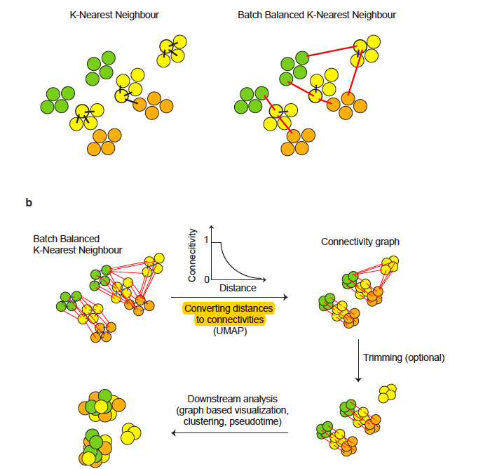
Batch balanced KNN, Python-based
Fast and intuitive tool for direct use in the scanpy workflow
Steps:
Identify the k nearest neighbors for each individual cell
KNN distances transformed to exponentially related connectivities (UMAP)
Downstream analysis (clustering, etc.)
Notes:
2nd method
inspired by MNN

Slide 7
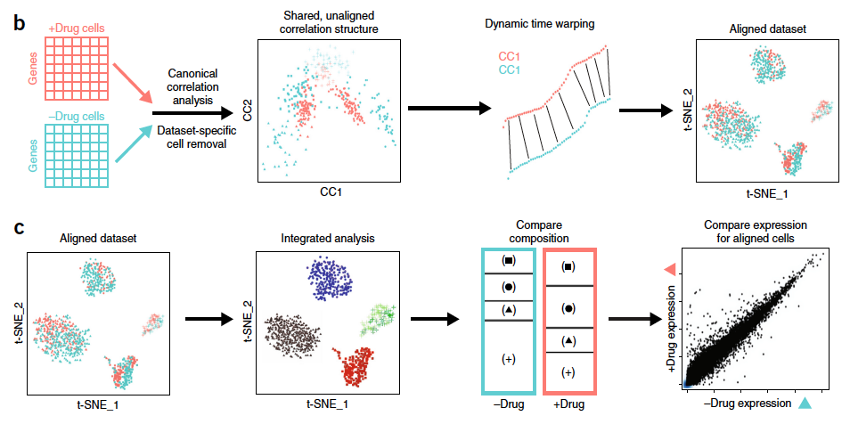
Seurat
Step1: Identifying shared correlation structures across data sets, using CCA
Step 2 (optional): Identify the non-overlapping cells
Step 3: Aligning datasets into a low-dimensional space,
using non-linear “warping”
Step 4: Integrated downstream analysis
(e.g. identify clusters)
Step 5: Comparative analysis on clusters /aligned subpopulations
Notes:
3rd method:
(CCA: canonical correlation analysis)
So actually we could use Seurat to do clustering as well.
You will see in a minute.

Slide 8
Quantile Normalization
Focus on the most highly expressed gene in each cell (e.g. cell A, B: gene 1, 2)
Calculate the mean expression for gene 1, 2
Quantile normalization = the mean
Continue to find the next most highly expressed gene in cell A, B
…
The original order of gene (in terms of expression) in each cell is preserved
Notes:
4th method:
You will see how that’s shown in the spearman correlation in the following presentation.

Slide 9
Workflow
Real dataset (expression matrix) → simulated batches → combined batches
removed batch effects → compared results
Calculated Normalized Mutual Information (NMI) between:
Clusters and the cell types (NMI1)
Clusters and the batches (NMI2)
Calculated Spearman correlation (rho value) between:
The data matrix before and after batch removal
Notes:
I used simulated data derived from real datasets.

Slide 10
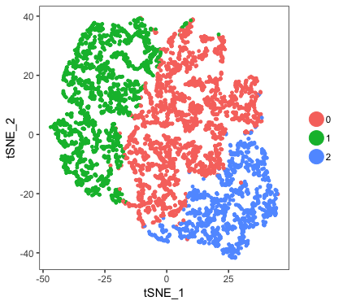
Original dataset: 3 cell types (A, B, C)
Clustering results using Seurat

Slide 11
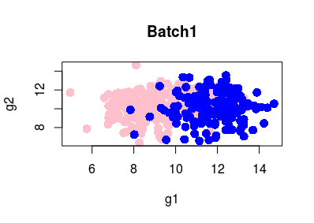
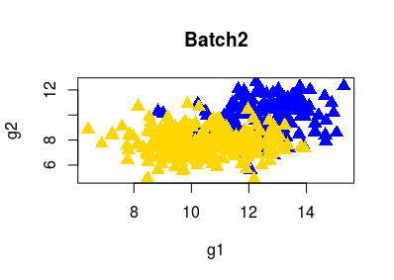
Simulated Dataset 1: Three cell types, two batches
Simulated batch (1 and 2), from real dataset
3 cell types, A, B, C
Batch1:
All cells of type A,B
Batch2:
All cells of type B,C
Original data: normalized
Added noise
Added batch effects
Notes:
The two batch share some population, while they also have some population that are distinct.
Plot of batch 1 and 2:
Each dot: a single cell
Color: cell type, blue ones: cell B
Shape: batch (batch1: circled; batch2: triangle)

Slide 12
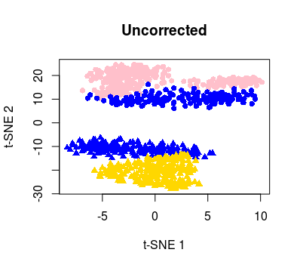
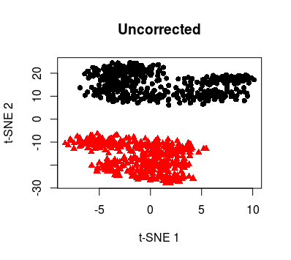
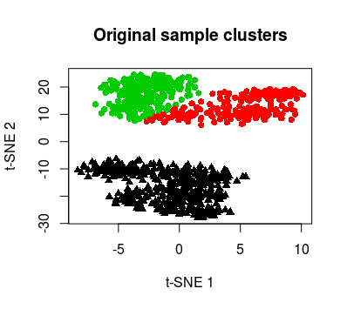
Before correction
Cell types
Batch
Kmeans clusters
NMI1 = 0.471022 (between clusters and cell types)
NMI2 = 0.6554545 (between clusters and batches)
Clusters have better correlation with batch.
Notes:
After I combined the two batches…tsne plots
colored by cell type:
kind of see 2 clusters
colored by batch
this just means the sample has batch effects.
so we're going to correct them.

Slide 13
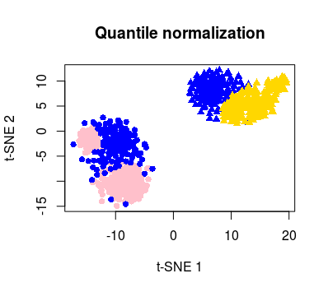
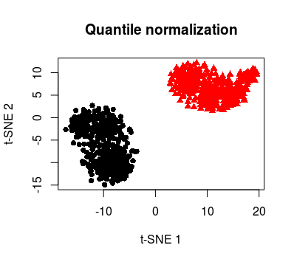
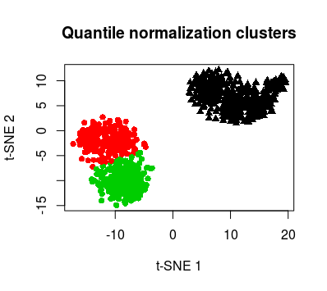
After Quantile Normalization (QN)
Cell types
Batch
Kmeans clusters
NMI1 = 0.4758208 (between clusters and cell types)
NMI2 = 0.6549884 (between clusters and batches)
Batch effects still observed.
Failed to remove batch effects.

Slide 14
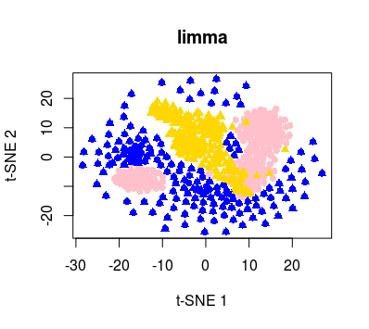
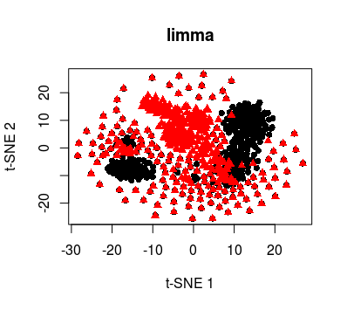
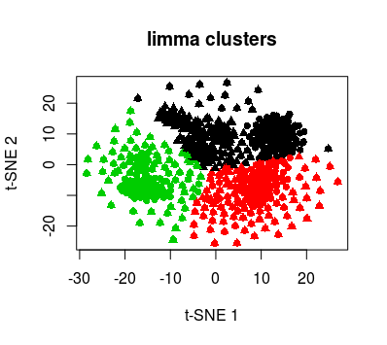
After limma correction
Cell types
Batch
Kmeans clusters
NMI1 = 0.1454289 (between clusters and cell types)
NMI2 = 0.01795887 (between clusters and batches)
No significant batch effects are observed.
Cell type clustering not ideal.
Notes:
But if we perform limma, the batch effects are removed pretty nicely.
NMI2 is much lower.
BUT NOTICE:
We do not want NMI2 to be too low,
because for the type A cells in batch 1, and the type C cells in batch 2, they have to form their own clusters.
In other words, those cells that are distint in the two batch should not be mixed together.
Let’s keep that in mind in the following slides as well.

Slide 15
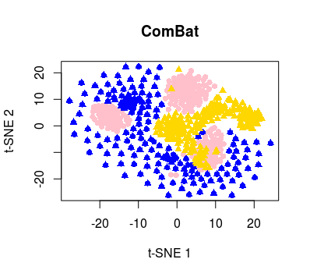
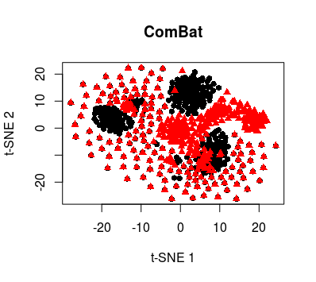
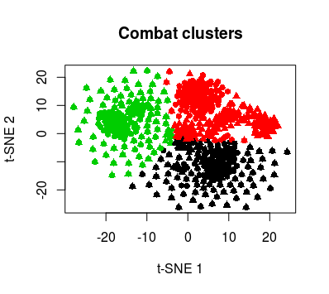
After ComBat correction
Cell types
Batch
Kmeans clusters
NMI1 = 0.1969745 (between clusters and cell types)
NMI2 = 0.01053399 (between clusters and batches)
Similar to limma.
No significant batch effects are observed.
Cell type clustering not ideal.
Notes:
Very low NMI for batch
But cell type clustering is not decent

Slide 16
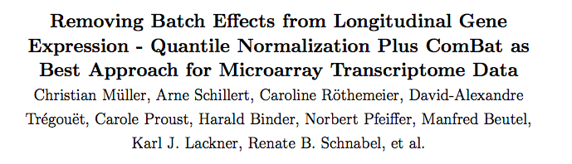
Quantile normalization + ComBat
Notes:
So I wanted to try this out

Slide 17
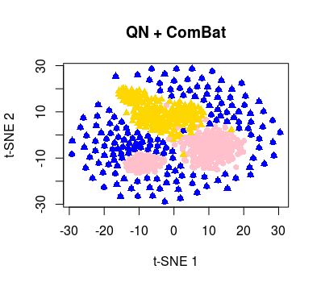
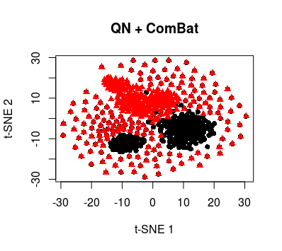
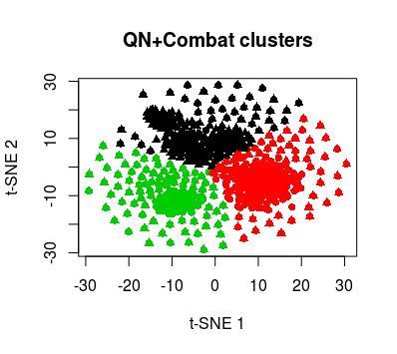
After QN + ComBat
Cell types
Batch
Kmeans clusters
NMI1 = 0.3940751 (between clusters and cell types)
NMI2 = 0.1893505 (between clusters and batches)
Better than using quantile normalization or ComBat alone.
Decent cell type clustering.
Notes:
Much higher nmi for cell type, a better cell type clustering
The batch are somewhat mixed
Better than each of them alone.
But is it the best method ever?
Let’s wait and see.

Slide 18
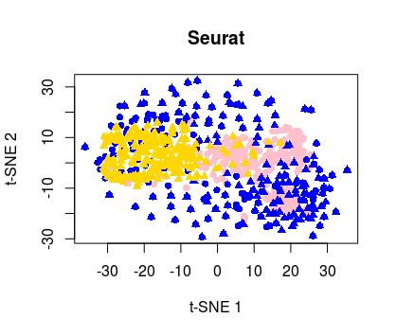
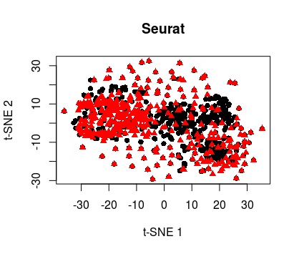
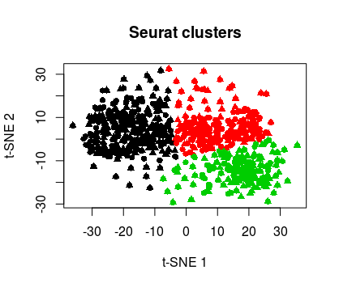
After Seurat correction
Cell types
Batch
Kmeans clusters
NMI1 = 0.2954129 (between clusters and cell types)
NMI2 = 0.08630642 (between clusters and batches)
No significant batch effects are observed.
Notes:
What about Seurat?
Well, the NMI2 is a bit too low in this case.
We see the yellow and pink cells which should be standing alone, mixed together with all the other cells.
But fortunately
Decent value for cell type clustering, tho not ideal (the graph: blue dots all over the place)
Note: cell_gene is the matrix multiplication of
batch.combined@dr$cca.aligned@cell.embeddings
%*%
t(batch.combined@dr$cca@gene.loadings)

Slide 19
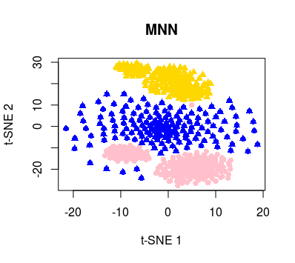
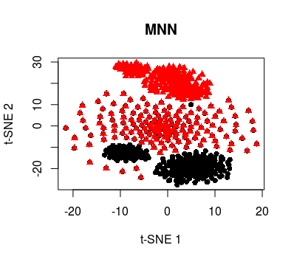
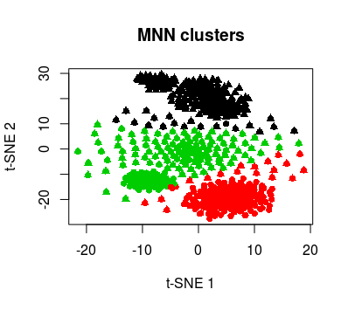
After MNN correction
Settings: k=20, sigma=0.5
Cell types
Batch
Kmeans clusters
NMI1 = 0.5742215 (between clusters and cell types)
NMI2 = 0.2600867 (between clusters and batches)
Decent cell type clustering
Batch effects removed nicely
Notes:
But if we look at MNN, it gives you what you want for cell type clustering.
Highest nmi score for cell types:
(graph) the three colors are eventually separating, corresponding to the three cell types.
Batch effects are removed
YOU might ask -- red and black on their own:
the distinct cell type within that batch
Note:
Adjusted k and sigma, both NMI values increase at the same time.
In other words, to get a better cell type clustering, the batch effects would remain.
I picked the para where the nmi2 is not too high, where nmi1 is good, meaning a good cell type clustering w/o sacrificing the batch removal too much.
# relatively optimal:
40 1 [1] 0.5900187 [1] 0.2655852
20 0.5 [1] 0.5742215 [1] 0.2600867

Slide 20
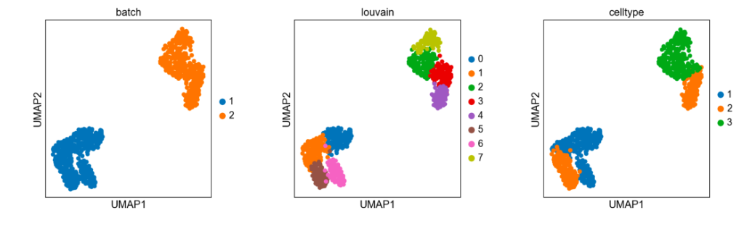
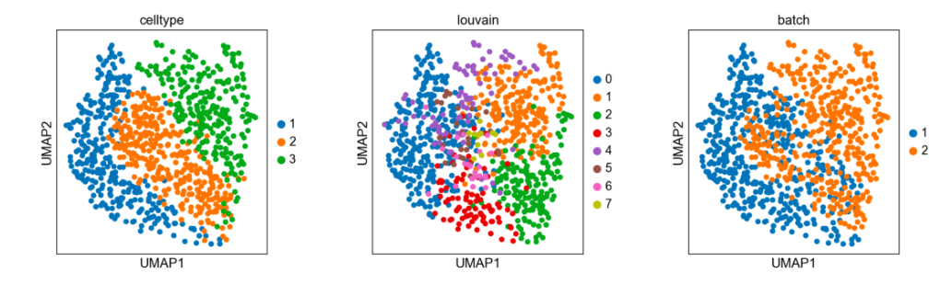
Before and after BBKNN correction (Python method)
NMI1 = 0.3605047
NMI2 = 0.2128341
Decent cell type clustering.
Batch effects removed.
Notes:
Let's transition from R to Python.
Generated UMAP plot
clearly distinguish the three cell types after BBKNN
the batch are somewhat mixed.
The distinct cell types are on their own.
NMI values: notice
come from louvain clustering, different from kmeans
So we probably can’t compare the NMI values straight with the previous ones
But they still serve a good purpose when we try to determine the effectiveness of batch removal

Slide 21
NMI values compared
Method NMI_by_cell_type NMI_by_batch
None: Uncorrected [1] 0.471022 [1] 0.6554545
MNN [1] 0.5742215 [1] 0.2600867
limma [1] 0.1454289 [1] 0.01795887
Quantile normalization [1] 0.4758208 [1] 0.6549884
ComBat [1] 0.1969745 [1] 0.01053399
QN + ComBat [1] 0.3940751 [1] 0.1893505
Seurat [1] 0.2954129 [1] 0.08630642
BBKNN 0.3605047 0.2128341
MNN and BBKNN showed better batch removal results.
Notes:
This is a chart showing the normalized mutual information for all methods.
Last column: correlation bet the clusters and batch after correction
Second column: correlation bet clusters and the cell types
After comparison: (point at nums)
MNN, the clusters showed the best correlation with the actual cell type
→ good clustering result
(relatively low nmi2)
Same with BBKNN

Slide 22
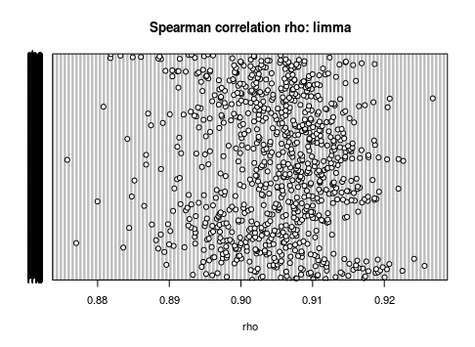
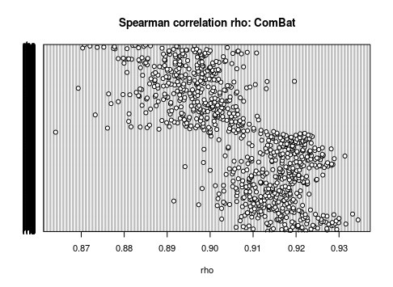
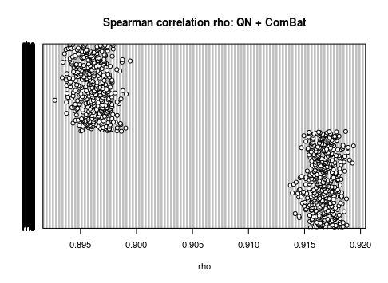
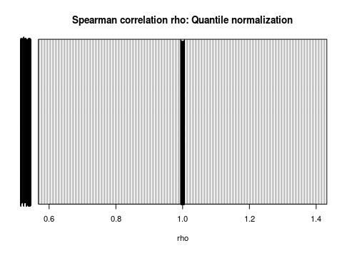
Spearman correlation: a comparison
Limma, combat: ~0.9
QN: 1
QN+combat: ~0.905
Notes:
That concludes the all the methods
which lead us to second parameter we used to quantify the batch removal,
Spearman correlation, measures...
x-axis: the rho value
y-axis: all the cells in the dataset

Slide 23
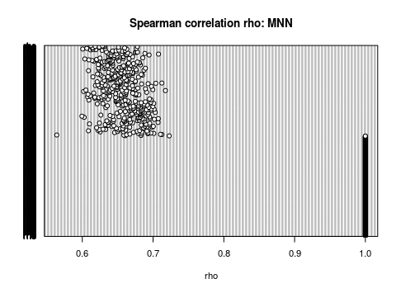
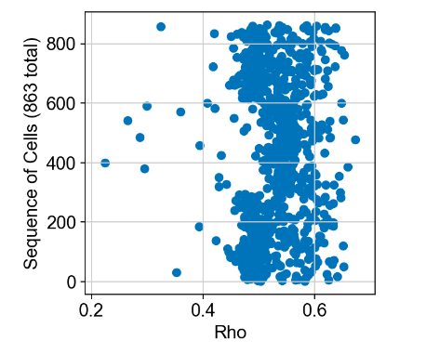
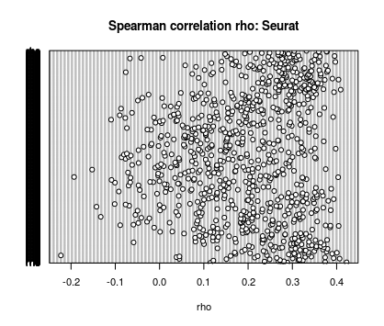
Spearman correlation: a comparison
BBKNN
MNN: ~0.65
BBKNN: ~0.5
Seurat: ~0.2
Seurat has the greatest distortion on the data.
Limma, combat, QN has the least.
Notes:
in this slide, the three methods have lower rho values
greater distortion of data
Seurat:
That’s why we did not pick Seurat as an optimal method in this case,
Because it distorts the data so much that it mixes the cells that shouldn’t be mixed

Slide 24
The second dataset

Slide 25
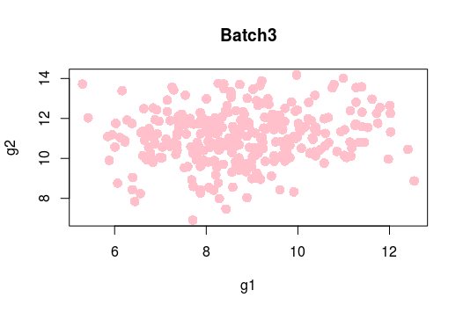
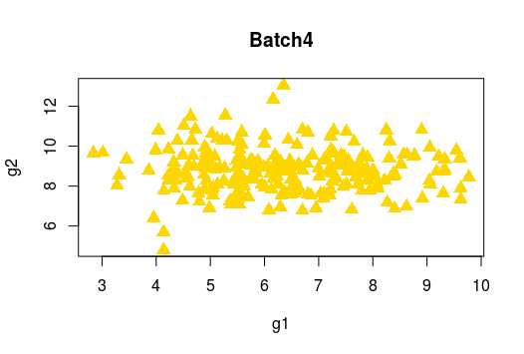
Simulated Dataset 2: Two distinct cell types
Simulated batch (3 and 4), from real dataset
2 cell types, A, C
Batch3:
All cells of type A
Batch4:
All cells of type C
Original data: normalized
Added noise
Added batch effects
See how each method mix the data where it shouldn’t be mixing them
Notes:
this is actually a trick for all the methods
because
the two batch I simulated did not have shared cell population
any questions about this dataset?

Slide 26
NMI values compared, for dataset 2
Method NMI_by_cell_type NMI_by_batch
None: Uncorrected [1] 0.6889163 [1] 0.6889163
MNN [1] 0.5418561 [1] 0.5418561
limma [1] 0.001546719 [1] 0.001546719
Quantile normalization [1] 1 [1] 1
ComBat [1] 0.01727682 [1] 0.01727682
QN + ComBat [1] 0.01470247 [1] 0.01470247
Seurat [1] 0.008285594 [1] 0.008285594
BBKNN 0.226796477 0.226796477
Limma, Seurat and ComBat failed to present a good correlation between the clusters and cell types.
MNN and BBKNN presented the best correlation among all the methods.
Notes:
Here's an overview of the NMI results
low values
Clusters did not align with the cell types
on the other hand...

Slide 27
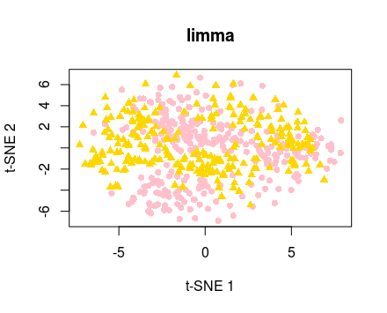
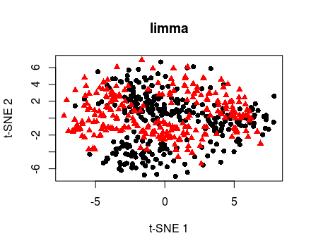
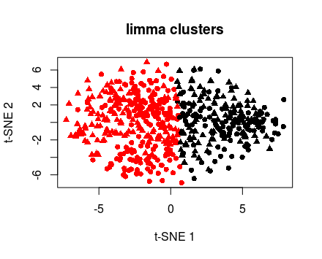
After limma “correction”
Cell types
Batch
Kmeans clusters
NMI = 0.001546719
Incorrect representation of the cell types.
Notes:
let's take a brief look at the graphs

Slide 28
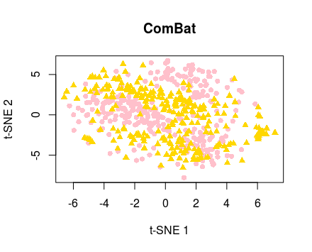
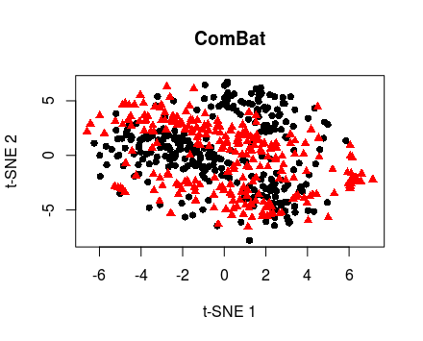
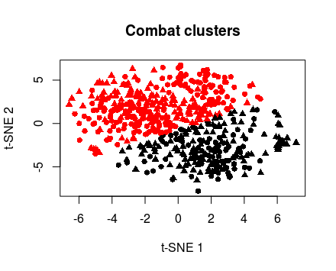
After ComBat “correction”
Cell types
Batch
Kmeans clusters
NMI = 0.01727682
Similar to limma.
Incorrect representation of the cell types.

Slide 29
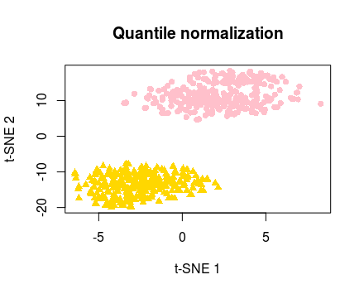


After Quantile Normalization (QN)
Cell types
Batch
Kmeans clusters
NMI = 1
Cell type clusters and batch remained the same.
Notes:
good in this case
but may not serve a good purpose in batch correction

Slide 30



After Seurat
Cell types
Batch
Kmeans clusters
NMI = 0.008285594
Generated an even mix of cells, where it shouldn’t be happening in this case.
Notes:
even worse

Slide 31



After MNN
Cell types
Batch
Kmeans clusters
NMI = 0.5418561
Preserved a good representation of cell types clustering.
Notes:
versus...
Remember we concluded MNN as one of the most effective methods from dataset1;
in this case, mnn has a better tolerance for this trick,
This still proves it to be a good method.

Slide 32


Before and after BBKNN
NMI = 0.226796477
Only showed a slight mix of distinct cell types
Notes:
Similar pattern
Robust tool to remove batch effects while tolerating this trick.

Slide 33




Spearman correlation: similar results with the previous dataset
Limma, combat: ~0.89
QN: 1
QN+ComBat: 0.895
Notes:
similar spearman correlation with the previous dataset
and I will skip these two slides

Slide 34



BBKNN
MNN: ~0.6
Seurat: ~0.1
BBKNN: ~0.5
Seurat has the most distortion on the data.
Limma, combat, QN has the least.

Slide 35
Summary
Method
Applied 6 different methods (in R or Python) to remove batch effects in simulated datasets
Compared each method based on the normalized mutual information (NMI) and spearman correlation (rho values)
Results
MNN and BBKNN showed better batch removal than other methods, and did not incorrectly distort the data, based on dataset1 and 2.
Seurat has the greatest distortion on the data.
Further steps
Test on more datasets
Compare each method under various conditions
MNN
Seurat
Limma
ComBat
BBKNN
Quantile Normalization

Slide 36
Acknowledgements
Professor Zhang
Dr. Ren
And all of you at Biopic!
Notes:
Professor Zhang:
for giving me the opportunity to intern here during the summer
Dr Ren:
mentoring me throughout project and giving me so many suggestions
you:
your help and patience.
I learnt a lot this summer. From R, to single cell RNA-seq techniques, and all those tools to remove batch effects.
And most importantly, I am very happy to get to know all of you. Thank you for everything, I really appreciate it.
Thank you!

Slide 37
THANK YOU

